Slide 1
Children online: Risks they might face
Awareness raising session – KS2
Notes:
Welcome
Introduction to you and the topic.
[Proposed intro]
‘As your child grows and becomes more independent, it is only natural that they take this independence online. In our teenage years we explore, try new things and sometimes push boundaries and take risks, this is an essential part of growing up.
With all of the potential that the online world and new technology offers, young people now have access to huge opportunities. They use technology to express themselves, explore, and be creative; it has changed the way they communicate.
The internet has changed all of our lives, and your child has grown up during this change. Many of the things that confuse, baffle or even scare us, are part of the everyday for them. For many of us, this can all be a bit too much.
Whether you’re a technophobe or a technophile, it’s still likely that you’ll be playing catch-up with the way your child is using the internet.’
You might wonder whether what they are doing is safe, and you might also be thinking how can I be as good a parent online as I am offline?

Slide 2












Slide 3
Musical.ly tik tok snapchat Instagram Whatsapp Fortnite
Omegle minecraft Facebook messenger Pokemon Roblox

Slide 4
Growing up online….
Notes:
From socialising to searching, online children are up to a range of activities. Read the possible suggestions on the slide. More information
on each topic can be found at – www.thinkuknow.co.uk/parents
It is important that the audience has an overview of all the elements/ functions that make up websites and technologies children use. These functions don’t often stand in isolation. A number of them are usually merged together into one online experience and service. E.g Facebook – has all 6 from this year (from 2013).

Slide 5
Growing up online….
Notes:
From socialising to searching, online children are up to a range of activities. Read the possible suggestions on the slide. More information
on each topic can be found at – www.thinkuknow.co.uk/parents
It is important that the audience has an overview of all the elements/ functions that make up websites and technologies children use. These functions don’t often stand in isolation. A number of them are usually merged together into one online experience and service. E.g Facebook – has all 6 from this year (from 2013).

Slide 6
Risks they might face....
Notes:
“As with the real world, there are risks online and it’s important that you teach your child how to navigate them.”
Inform the audience that during your session you will talk through all the risks in depth and offer tips which can be simply implemented within the home.
Read through the list and ask the audience to put their hands up when it comes to the risk they are most worried about, then ask a small number of the audience why they are most concerned about that risk in particular.

Slide 7
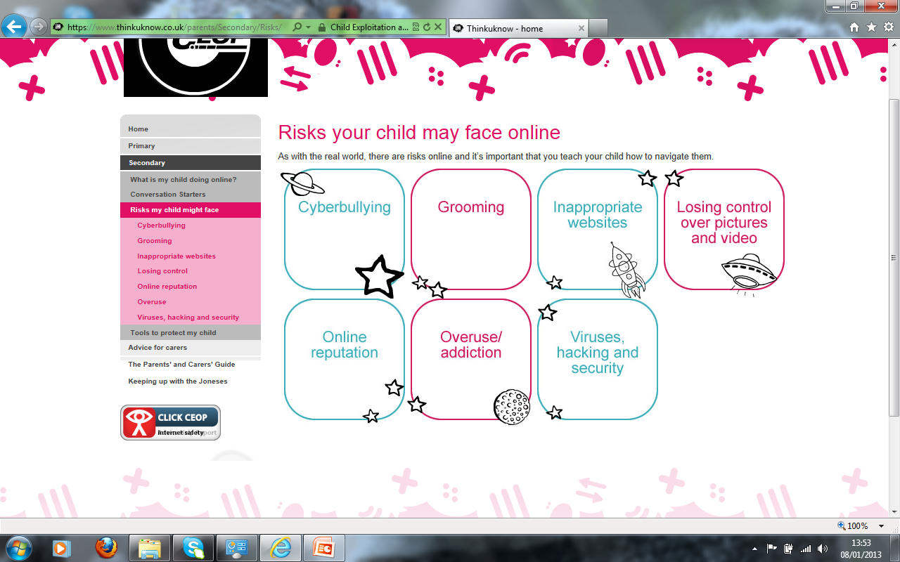
Inappropriate content
Not age appropriate:
Violence
Racial Hate
Pro eating disorders
Gambling
Pornographic
What does the
‘inappropriate’
mean in your house?
Notes:
Ask the audience what the word ‘inappropriate’ means to them and within their home? Responses often depend on the age of their child.
[Content below taken from a CEOP Inappropriate Websites factsheet, available for download]
“The Internet is open to anyone to post and create content so sometimes your child may see things they wish they hadn’t, or access sites that are inappropriate for their age. Inappropriate can mean different things to different people, from swear words to pornographic images or videos, and what is inappropriate for your child will also change as they grow and develop.
There are a range of things online that might upset children and affect what should be a healthy online experience. It’s important to remember that inappropriate content online includes pornographic content, but could also include other content such as race hate, pro eating disorders, or gambling sites.
23% of 8 – 11 year olds say they dislike inappropriate content online as do 15% of 12 – 15 year olds.
Ofcom, Parents views on parental controls 2012
If your child is using the internet, you should discuss the type of things they might see no matter what age they are.”

Slide 8
Inappropriate content

Slide 9
Inappropriate content

Slide 10
Inappropriate contact

Slide 11
What is online grooming?
What does an online friend mean to your child? Is it the same for you?
Notes:
Ask the audience how they believe grooming to ‘work’ online? What does an online friend mean to your child? Is it the same for you?
How would an offender make contact with a child?
Play module produced by CEOP
[Content below taken from a CEOP Grooming factsheet, available for download]
“Grooming is a process used to prepare a child for sexual abuse. An offender’s aim when grooming will be to gain access to a child and build a relationship with that child. Grooming can take many different forms, from one off contact which may include sexual advances, to a series of events over time. It may start with an adult scanning websites to identify a vulnerable child or befriending a child, perhaps by pretending to have common hobbies or interests or using flattery to trick a child into trusting them.
Online it is easier for an offender to lie and gain one to one contact with a child, for example through a social networking or gaming site. They can share images or videos relating to their pretended common interests and build a ‘relationship’ away from any adult supervision.
Once a relationship is established an offender may then introduce sexual themes to the conversation, for example, asking the child about their sexual experiences, sharing pornography with them or asking them for sexual pictures of themselves. Different offenders will have different approaches so whereas this process may be very quick it can also take days, weeks or even months. Often an offender will attempt to get a child to meet them in the real world in order to abuse them. Increasingly some offenders are also persuading children to perform sexual acts on webcam.”

Slide 12


Slide 13
Top tips
Talk to your child about online grooming
Talk to them about their online friends
Let your child know that you are always there for support and you understand how easy it is for things to get out of control online
Learn how to report any inappropriate contact made to your child online
Notes:
Give the audience time to discuss the top tips. Ask if anyone has anyone already discussed grooming with their child, if so, how did they approach the topic? If not, explain how easy it can be with the thinkuknow resources.
Talk to your child about online grooming. Explain how easy it can be to lie online and the reasons why an adult may wish to contact them online.
Talk about their online friends. Ask them to think carefully about who they chat and share information with. If they don’t know them in the real world they need to delete or limit what they share with them, such as their location, photos and videos.
Use the Thinkuknow resources to open a conversation about grooming with your child. Our age appropriate education films are available through the parents and carers website or CEOP youtube channel.
Let your child know that you are always there for support. Let them know that you understand how easy it can be to get into difficulties online. Get them to talk to you if anyone makes inappropriate/ sexual comments and that, no matter what’s happened, you are there to help.
Learn how to report any inappropriate contact made to your child online. This can be done via the ClickCEOP button at CEOP.police.uk

Slide 14
Top tips
Notes:
Give the audience time to discuss the top tips. Ask if anyone has anyone already discussed grooming with their child, if so, how did they approach the topic? If not, explain how easy it can be with the thinkuknow resources.
Talk to your child about online grooming. Explain how easy it can be to lie online and the reasons why an adult may wish to contact them online.
Talk about their online friends. Ask them to think carefully about who they chat and share information with. If they don’t know them in the real world they need to delete or limit what they share with them, such as their location, photos and videos.
Use the Thinkuknow resources to open a conversation about grooming with your child. Our age appropriate education films are available through the parents and carers website or CEOP youtube channel.
Let your child know that you are always there for support. Let them know that you understand how easy it can be to get into difficulties online. Get them to talk to you if anyone makes inappropriate/ sexual comments and that, no matter what’s happened, you are there to help.
Learn how to report any inappropriate contact made to your child online. This can be done via the ClickCEOP button at CEOP.police.uk

Slide 15
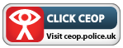

Report and Support
Report suspected online grooming – this could sexual chat, a child being asked to do something that makes them feel uncomfortable or someone insisting on meeting up .
www.ceop.police.uk
24 hour confidential helpline for children and young people .
Notes:
Inform the audience that there are support and report services available to them and their child.
Further information on CEOP - “If your child has been approached by an adult online. This contact could involve sexual chat, being asked to do something that makes them feel uncomfortable or someone insisting on meeting up. Contact CEOP at – www.ceop.police.uk”
Further information on Childline - “Sometimes children feel like they don’t want to talk to anyone in there family about what's happening to them. Inform them you are always there to listen, but if this ever becomes the case, there are experienced councillors at childline (24/7) who are there for them.”
[Content below is taken from a CEOP Grooming factsheet, available for download]
“The Child Exploitation and Online Protection Centre (CEOP)
CEOP is a police led, child protection agency which specialises in tackling sexual abuse on and offline. Through its Education Programme, Thinkuknow CEOP offers a range of safety information for children, young people, practitioners and parents/carers. For more information visit www.thinkuknow.co.uk/parents.
Reporting to CEOP
If someone has acted inappropriately towards your child, it may be sexual chat, being asked to do something that makes you feel uncomfortable or someone being insistent on meeting up. You must report it to ClickCEOP at www.ceop.police.uk.” Taken from a CEOP Grooming factsheet, available for download.

Slide 16
Inappropriate conduct
Cyberbullying

Slide 17
Top tips
Offer reassurance and support. Don’t be afraid to ask questions
Tell your child that if they are being bullied to always keep the evidence
Block the bullies
Learn how to report and where to go for further support
Notes:
Discuss the top tips and ask if anyone needs any further clarification on any of the points mentioned.
Offer reassurance and support. Your child may be in need of emotional support or feel like they have nowhere to turn. It is rare that Cyberbullying is only taking place online and is often someone your child knows through school or a group they attend. Their school should have policies and procedures for dealing with cyberbullying.
Your child could visit Cybermentors, who are an online counseling service with a difference; the councilors are also
children and young people. This site has proved very popular and offers practical advice - www.cybermentors.org.
Tell your child that if they are being bullied to always keep the evidence. Whether it’s a text message or email, tell them not to reply to the bully or delete the comments. Ask your child if they know the bully or where the messages are coming from. Often it is someone within the school environment and can be dealt with quickly and effectively with assistance from the school.
Block the bullies
If someone is bullying your child on a social networking or chat site encourage them to block or delete them so that
they can’t contact them anymore.
Report any bullying content to the website it’s hosted on. If content has been posted, for example a video or image, which is upsetting your child you should report it to the website, for example, Facebook. Learn how you would report content on sites like Facebook and YouTube; every site is different. Contacting the website is the only way to get the offensive content removed, unless it is illegal. In cases of illegal content for example indecent images or videos of young people under 18, contact your local police or report it to www.clickceop.police.uk.
For further information on all internet related issues and risks visit – www.thinkuknow.co.uk

Slide 18
Sharing private information
Most social media sites allow young users to host a public profile, which presents many concerns regarding their privacy. If privacy settings are not applied, the content they publish on their profiles will be accessible to millions of people worldwide.
This information can potentially include:
personal contact details;
photographs or videos of themselves and their friends;
the names and addresses of the schools and clubs they attend;
their exact locations at any given time through the use of location tagging features.

Slide 20
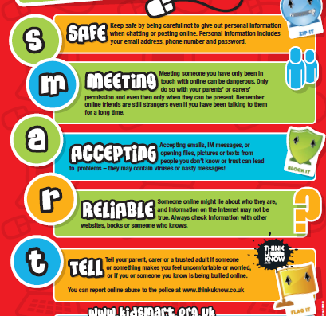

Slide 21
Social media Age Restrictions
13/18 with Parents Permission
YouTube
Keek
WeChat
Kik
Foursquare
Flickr
EA
Minecraft
Moshi Monsters
Vimeo
From age 13
Facebook
Twitter
Instagram
Pinterest
Google+
Tumblr
Reddit
Snapchat
AskFM
Steam
From age 16
WhatsApp
From age 14
LinkedIn
From age 17
Vine
Tinder
Skype

Slide 22
Game ratings
Fortnite – 12 years old
Roblox – 7+
Clash of Clans – 13+
Movie Star Planet – 8+
Grand Theft Auto – 18+
https://www.net-aware.org.uk/ - reviews apps and games

Slide 23
IPAD/IPhone Restrictions
Types of content
Ratings For (select the country or region in the ratings section to automatically apply the appropriate content ratings for that region)
Music, Podcasts & News
Movies
TV shows
Books
Apps
Siri
Websites
Password Settings
Apps and features
Safari (Internet browser)
Camera (also disables FaceTime)
Siri & Dictation
FaceTime*
AirDrop
iTunes Store
Podcasts
News
Installing apps
Deleting apps
In-App Purchases
Multiplayer Games
Adding Friends
Privacy settings
Location Services
Contacts
Calendars
Photos
Share My Location
Bluetooth sharing
Microphone
Speech Recognition
Twitter
Facebook
Advertising
When you have Restrictions on, you might not see certain apps, features, or services. If you're missing an app or feature, or can't use a certain service, try turning Restrictions off.
If you lose or forget your Restrictions passcode, you need to erase your device, then set it up as a new device to remove the Restrictions passcode.

Slide 24
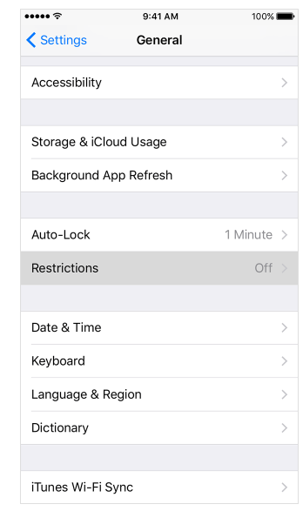
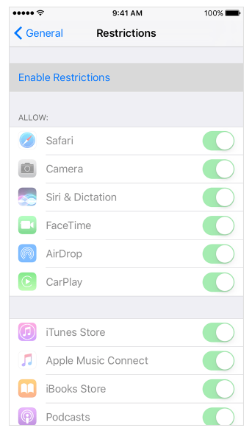
IPAD/IPhone Restrictions
1. Tap Settings > General > Restrictions
2. Scroll down and tap Restrictions, then Enable Restrictions
3. Create a Restrictions passcode

Slide 25
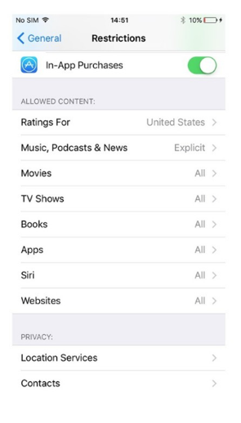
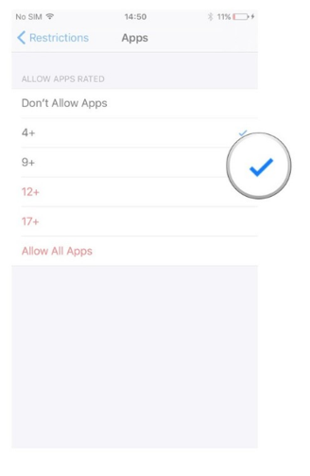
Age Based Restrictions
5. Select the age band appropriate for your child. Applying a ‘tick’ to that age will allow access.
4. Restrictions > Apps/music/movies

Slide 26
limit access on your home wireless setup
Depending on your home router you can create a separate SSID (The name of your wireless connection) so that you have an grownup unrestricted version, or a child based locked down version. For example:
Wireless Name for Adult connection: Mywireless (Apply a password that’s the kids do not know)
Wireless Name for Child connection: Mywireless Kids (Apply a password that the kids remember)
You can then apply restriction on your home router on the kids version so that should they try and access the internet, access to explicit websites will be blocked

Slide 27
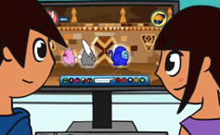
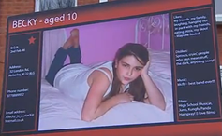
Conversation starter….
View age appropriate animations and films at - www.thinkuknow.co.uk/parents
www.youtube.com/ceop
5-7
Lee and Kim’s Adventure: Animal Magic
Animation – Be nice to people,
like you would in the playground
8-10
Jigsaw
10 minute film about
Safe Social Networking
Notes:
Allow at least 12 minutes for this section. Use this time to explain what your school/ organisation are doing to educate
the children you look after and play one of the resources available (you will need to download and embed the film you
would like to show before the session. You can do this by visiting www.thinkuknow.co.uk/teachers/resources
[CEOP advise parents to watch these films with their child in the comfort of their own homes. It is a great way to open dialogue about their online life and shows them that you understand the complexities of the issues faced. Hopefully they will feel secure in approaching you if they feel out of control or are uncomfortable with something they see online.
Parents and Carers can view CEOP’s films at – www.thinkuknow.co.uk/parents / www.youtube.co.uk/ceop

Slide 28
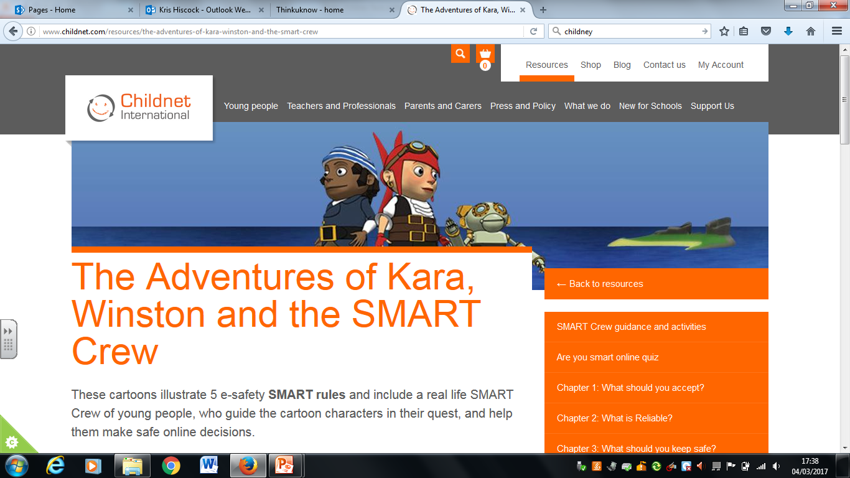
http://www.childnet.com/resources/the-adventures-of-kara-winston-and-the-smart-crew

Slide 29
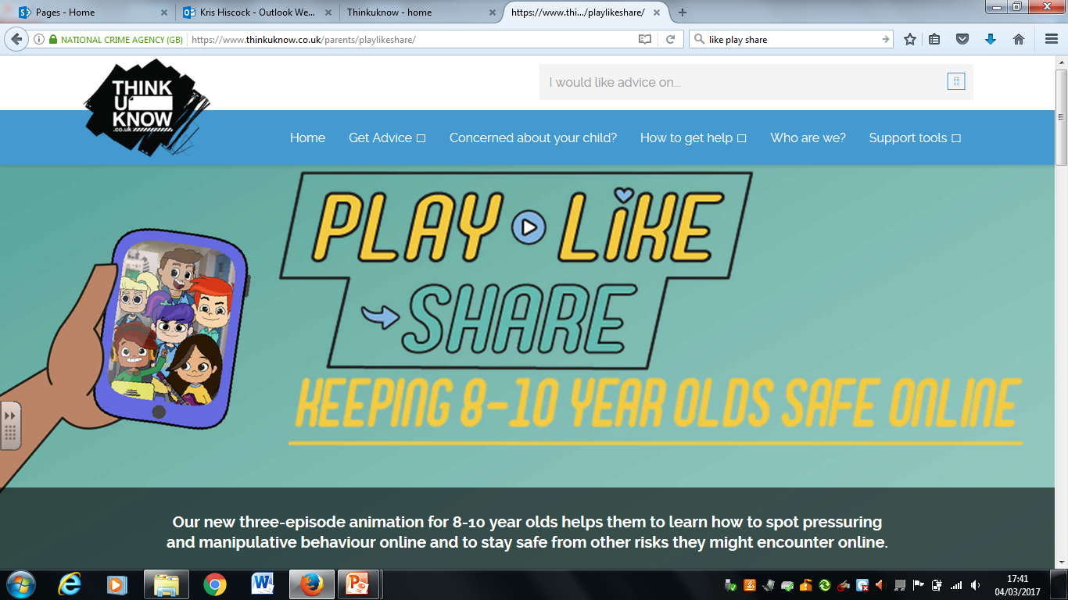
https://www.thinkuknow.co.uk/parents/playlikeshare/

Slide 30
For more information…
www.thinkuknow.co.uk/parents
www.facebook.com/ceop
www.twitter.com/ceop
https://www.net-aware.org.uk/
https://www.vodafone.com/content/digital-parenting.html
https://www.childnet.com/
Notes:
Sign post CEOP’ s parents and carers website. This is where your audience can go for more information on all of the topics discussed and more.

