Slide 1
Children online: Risks they might face
Awareness raising session – KS1
Notes:
Welcome
Introduction to you and the topic.
[Proposed intro]
‘As your child grows and becomes more independent, it is only natural that they take this independence online. In our teenage years we explore, try new things and sometimes push boundaries and take risks, this is an essential part of growing up.
With all of the potential that the online world and new technology offers, young people now have access to huge opportunities. They use technology to express themselves, explore, and be creative; it has changed the way they communicate.
The internet has changed all of our lives, and your child has grown up during this change. Many of the things that confuse, baffle or even scare us, are part of the everyday for them. For many of us, this can all be a bit too much.
Whether you’re a technophobe or a technophile, it’s still likely that you’ll be playing catch-up with the way your child is using the internet.’
You might wonder whether what they are doing is safe, and you might also be thinking how can I be as good a parent online as I am offline?

Slide 2












Slide 3
Musical.ly tik tok snapchat Instagram Whatsapp Fortnite
Omegle minecraft Facebook messenger Pokemon Roblox

Slide 4
Growing up online….
Notes:
From socialising to searching, online children are up to a range of activities. Read the possible suggestions on the slide. More information
on each topic can be found at – www.thinkuknow.co.uk/parents
It is important that the audience has an overview of all the elements/ functions that make up websites and technologies children use. These functions don’t often stand in isolation. A number of them are usually merged together into one online experience and service. E.g Facebook – has all 6 from this year (from 2013).

Slide 5
Growing up online….
Notes:
From socialising to searching, online children are up to a range of activities. Read the possible suggestions on the slide. More information
on each topic can be found at – www.thinkuknow.co.uk/parents
It is important that the audience has an overview of all the elements/ functions that make up websites and technologies children use. These functions don’t often stand in isolation. A number of them are usually merged together into one online experience and service. E.g Facebook – has all 6 from this year (from 2013).

Slide 6
Risks they might face....
Notes:
“As with the real world, there are risks online and it’s important that you teach your child how to navigate them.”
Inform the audience that during your session you will talk through all the risks in depth and offer tips which can be simply implemented within the home.
Read through the list and ask the audience to put their hands up when it comes to the risk they are most worried about, then ask a small number of the audience why they are most concerned about that risk in particular.

Slide 7
Inappropriate content

Slide 8
Inappropriate conduct
Cyberbullying

Slide 9
Top tips
Offer reassurance and support. Don’t be afraid to ask questions
Tell your child that if they are being bullied to always keep the evidence
Block the bullies
Learn how to report and where to go for further support
Notes:
Discuss the top tips and ask if anyone needs any further clarification on any of the points mentioned.
Offer reassurance and support. Your child may be in need of emotional support or feel like they have nowhere to turn. It is rare that Cyberbullying is only taking place online and is often someone your child knows through school or a group they attend. Their school should have policies and procedures for dealing with cyberbullying.
Your child could visit Cybermentors, who are an online counseling service with a difference; the councilors are also
children and young people. This site has proved very popular and offers practical advice - www.cybermentors.org.
Tell your child that if they are being bullied to always keep the evidence. Whether it’s a text message or email, tell them not to reply to the bully or delete the comments. Ask your child if they know the bully or where the messages are coming from. Often it is someone within the school environment and can be dealt with quickly and effectively with assistance from the school.
Block the bullies
If someone is bullying your child on a social networking or chat site encourage them to block or delete them so that
they can’t contact them anymore.
Report any bullying content to the website it’s hosted on. If content has been posted, for example a video or image, which is upsetting your child you should report it to the website, for example, Facebook. Learn how you would report content on sites like Facebook and YouTube; every site is different. Contacting the website is the only way to get the offensive content removed, unless it is illegal. In cases of illegal content for example indecent images or videos of young people under 18, contact your local police or report it to www.clickceop.police.uk.
For further information on all internet related issues and risks visit – www.thinkuknow.co.uk

Slide 10
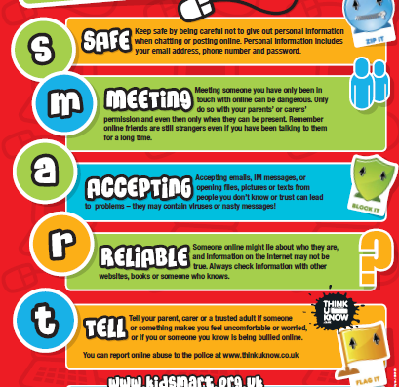

Slide 11
Social media Age Restrictions
13/18 with Parents Permission
YouTube
Keek
WeChat
Kik
Foursquare
Flickr
EA
Minecraft
Moshi Monsters
Vimeo
From age 13
Facebook
Twitter
Instagram
Pinterest
Google+
Tumblr
Reddit
Snapchat
AskFM
Steam
From age 16
WhatsApp
From age 14
LinkedIn
From age 17
Vine
Tinder
Skype

Slide 12
Game ratings
Fortnite – 12 years old
Roblox – 7+
Clash of Clans – 13+
Movie Star Planet – 8+
Grand Theft Auto – 18+
https://www.net-aware.org.uk/ - reviews apps and games

Slide 13
IPAD/IPhone Restrictions
Types of content
Ratings For (select the country or region in the ratings section to automatically apply the appropriate content ratings for that region)
Music, Podcasts & News
Movies
TV shows
Books
Apps
Siri
Websites
Password Settings
Apps and features
Safari (Internet browser)
Camera (also disables FaceTime)
Siri & Dictation
FaceTime*
AirDrop
iTunes Store
Podcasts
News
Installing apps
Deleting apps
In-App Purchases
Multiplayer Games
Adding Friends
Privacy settings
Location Services
Contacts
Calendars
Photos
Share My Location
Bluetooth sharing
Microphone
Speech Recognition
Twitter
Facebook
Advertising
When you have Restrictions on, you might not see certain apps, features, or services. If you're missing an app or feature, or can't use a certain service, try turning Restrictions off.
If you lose or forget your Restrictions passcode, you need to erase your device, then set it up as a new device to remove the Restrictions passcode.

Slide 14
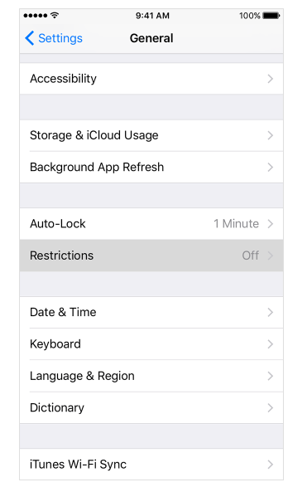
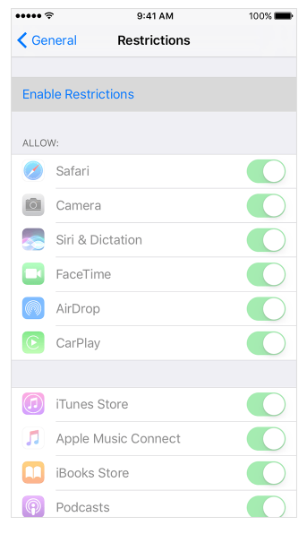
IPAD/IPhone Restrictions
1. Tap Settings > General > Restrictions
2. Scroll down and tap Restrictions, then Enable Restrictions
3. Create a Restrictions passcode

Slide 15
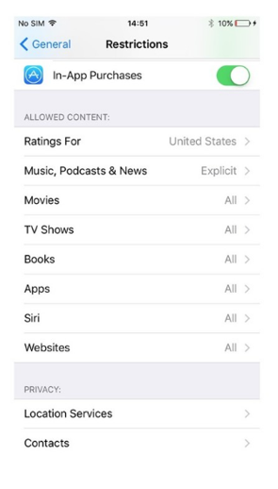
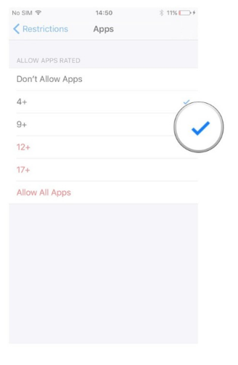
Age Based Restrictions
5. Select the age band appropriate for your child. Applying a ‘tick’ to that age will allow access.
4. Restrictions > Apps/music/movies

Slide 16
limit access on your home wireless setup
Depending on your home router you can create a separate SSID (The name of your wireless connection) so that you have an grownup unrestricted version, or a child based locked down version. For example:
Wireless Name for Adult connection: Mywireless (Apply a password that’s the kids do not know)
Wireless Name for Child connection: Mywireless Kids (Apply a password that the kids remember)
You can then apply restriction on your home router on the kids version so that should they try and access the internet, access to explicit websites will be blocked

Slide 17
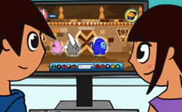
Conversation starter….
View age appropriate animations and films at - www.thinkuknow.co.uk/parents
www.youtube.com/ceop
5-7
Lee and Kim’s Adventure: Animal Magic
Animation – Be nice to people,
like you would in the playground
https://www.thinkuknow.co.uk/parents/jessie-and-friends-videos/
https://www.thinkuknow.co.uk/parents/jessie-and-friends/
Notes:
Allow at least 12 minutes for this section. Use this time to explain what your school/ organisation are doing to educate
the children you look after and play one of the resources available (you will need to download and embed the film you
would like to show before the session. You can do this by visiting www.thinkuknow.co.uk/teachers/resources
[CEOP advise parents to watch these films with their child in the comfort of their own homes. It is a great way to open dialogue about their online life and shows them that you understand the complexities of the issues faced. Hopefully they will feel secure in approaching you if they feel out of control or are uncomfortable with something they see online.
Parents and Carers can view CEOP’s films at – www.thinkuknow.co.uk/parents / www.youtube.co.uk/ceop

Slide 19
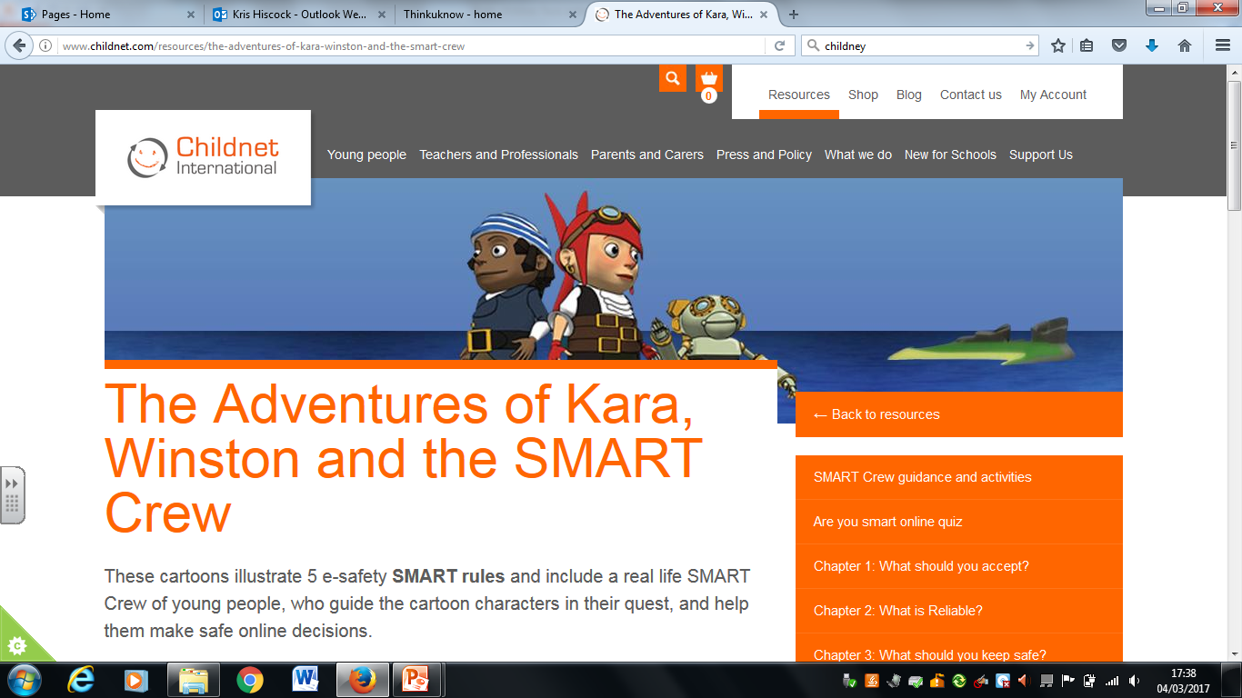
http://www.childnet.com/resources/the-adventures-of-kara-winston-and-the-smart-crew

Slide 20
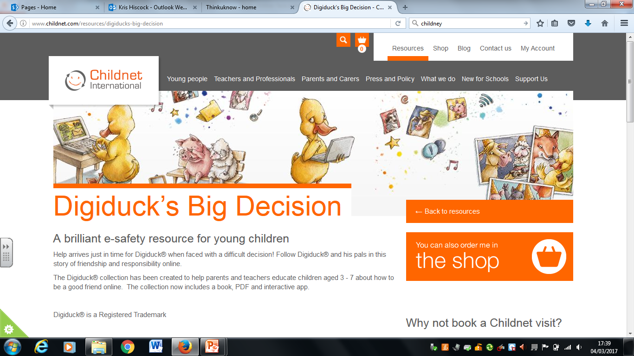
http://www.childnet.com/resources/digiducks-big-decision

Slide 21
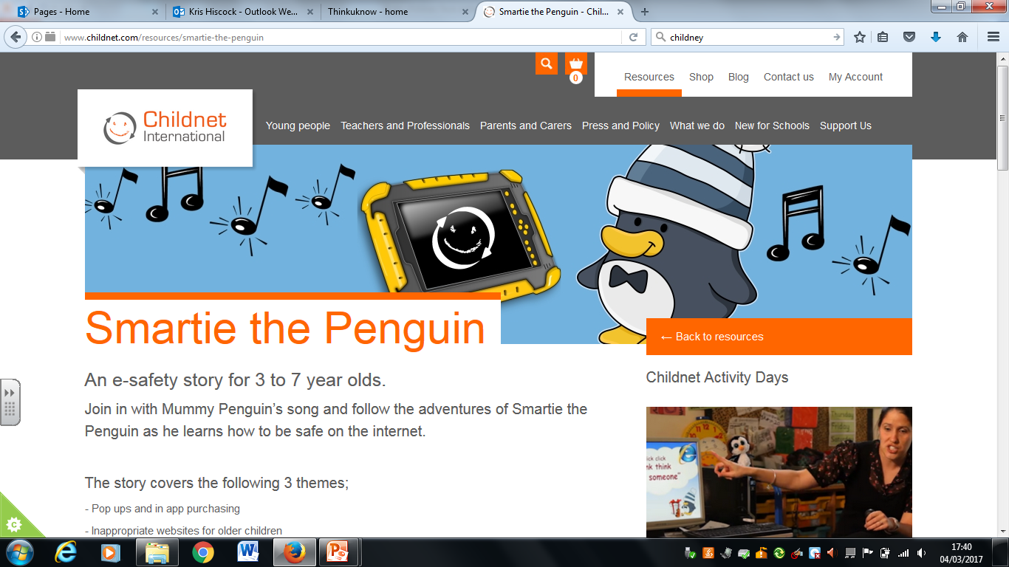
http://www.childnet.com/resources/smartie-the-penguin

Slide 22
For more information…
www.thinkuknow.co.uk/parents
www.facebook.com/ceop
www.twitter.com/ceop
https://www.net-aware.org.uk/
https://www.vodafone.com/content/digital-parenting.html
https://www.childnet.com/
Notes:
Sign post CEOP’ s parents and carers website. This is where your audience can go for more information on all of the topics discussed and more.

