Slide 1

Safer Internet Day 2021
An internet we trust: exploring reliability in the online world
This year in the UK, Safer Internet Day explores reliability online. The internet has an amazing range of information and opportunities online, but how do we separate fact from fiction?

Slide 2

What can parents and carers do to help?

Slide 3
Teaching to think critically – 3-7 years
Even if they are not actively seeking out new information, children this age are learning constantly from the things they see and hear online.
Video content, apps and games can provide exciting opportunities for children to explore and learn, the search bar on any web browser can open up endless possibilities, and the excitement of asking a question aloud to a voice activated device (e.g. Alexa or Siri) show the many magical ways that technology can open young children’s eyes to the world around them.
https://www.childnet.com/parents-and-carers/hot-topics/critical-thinking/3-7-year-olds

Slide 4
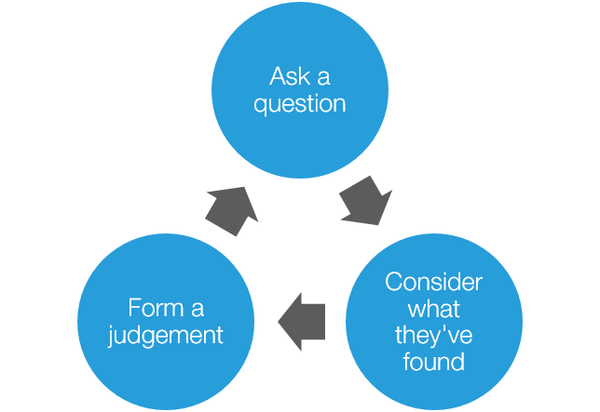
It is important they recognise that not everything they see and hear online is true and establishing basic critical thinking skills early on will help prepare them to navigate the online world as they grow.
Children aged 3-7 will benefit most from being encouraged to be curious and to question the things they see and hear both online and offline.
https://www.childnet.com/parents-and-carers/hot-topics/critical-thinking/3-7-year-olds

Slide 5
Top Tips for supporting children aged 3-7
Explore the internet together
Choose a topic your child is interested in and spend some time investigating it together online. Talk about the things you see and hear, asking questions like: “What do you think about this?” or “Does that sound right to you?”
Establish good habits early on
Encourage helpful habits like checking more than one source. This can be done in a very simple way – “This website says this, shall we check another one and see what that says?” or “That video was really interesting, shall we look in the library for a book about the same subject?”
Provide strategies for getting help
As they begin to use devices and the internet more independently, make sure your child knows they can come to you if they ever see something confusing or that they’re not sure about. You could also talk about who could help them at school or if they’re visiting a friend.
Practise critical thinking skills offline too
Whilst critical thinking is a vital skill online, it is useful offline too. You can practise these skills really simply as you come across information on a day-to-day basis. For example if an advert claims something is ‘the best’, ask “Do you think it actually is the best?”

Slide 6
Teaching to think critically – 7-11 years
Children this age are frequent and increasingly self-assured internet users. Whether it’s research for a project, games, apps, video content, or their first experiences of social media, they are likely to be seeing and hearing new things online on a near daily basis. By the time children reach this age, they are more likely to be familiar with the idea that not everything they find online is reliable, but may find it challenging to put this understanding into practice and think critically about the information they come across on different online platforms.
https://www.childnet.com/parents-and-carers/hot-topics/critical-thinking/7-11-year-olds

Slide 7
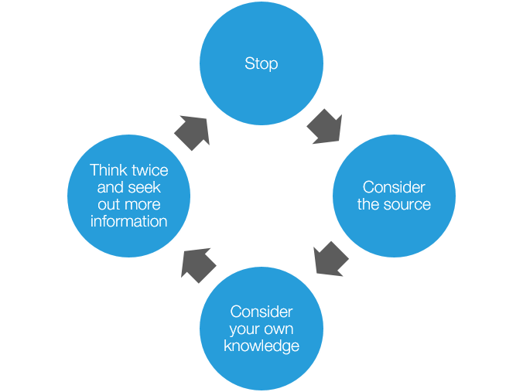
It’s vital that they are taught how to practise and develop their critical thinking skills, as well as which contexts they need to apply them in. This will help them navigate the internet with increasing independence and confidence.
Online videos
Are any more or less trustworthy?
Do they all give the same information?
Do any of the videos say different things to each other?
Does this information match what you already know about this subject?
Do we know enough about this subject to be able to decide if this video is reliable or not?
https://www.childnet.com/parents-and-carers/hot-topics/critical-thinking/7-11-year-olds

Slide 8
Top Tips to share with children aged 7-11
Consider the source – Where has this information come from and do we have reason to trust it? Has it come from an expert or has it come from someone who has something to gain by getting us to believe what they’re saying? (E.g. An advert will always want to make the product being sold sound good, to convince us to buy it!)
Consider your own knowledge – What do we already know about this subject? Does what we’re seeing online match-up with this? Or does it contradict it? Do we know enough about this subject to be able to make an accurate judgement on its reliability?
Not sure about the source or your own knowledge? Then it’s time to think twice!
Check another source – there’s lots of information out there so let’s see what else we can find on this subject. Check another website, watch another video or maybe even find a book on the same topic. The more sources that seem to say the same thing, and the more reliable those sources, the more confident we can be that the information can be trusted!
Check with an adult – still not sure? Maybe all the sources still have different information to one another? We can always ask an adult we trust for help. Sometimes there is no right answer – and that’s okay, but it’s best to have all the information and points of view before we make a decision.

Slide 9
A video to share at home

Slide 10
Websites for more information
www.childnet.com
Internetmatters.org
Saferinternet.org.uk
https://www.nspcc.org.uk/keeping-children-safe/online-safety/

